Slide 1
OOP using python

Slide 2
Outline
OOP definition
Why OOP
OOP Keywords
Relations

Slide 3
Object-Oriented Programming (OOP)
Is a programming paradigm in computer science that relies on the concept of classes and objects.
Think as data and actions.
It is used to structure a software program into simple, reusable pieces of code blueprints (usually called classes)
There are many object-oriented programming languages, including JavaScript, C++, Java, and Python.
Python support OOP and procedural paradigm.

Slide 4
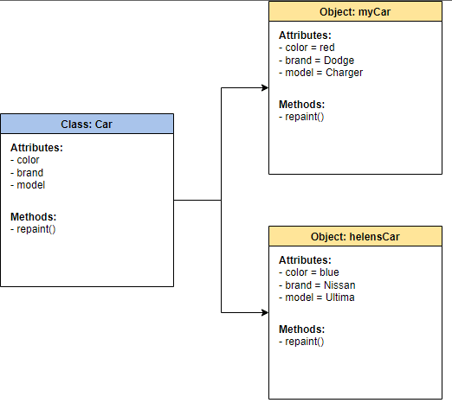
Object-Oriented Programming (OOP)

Slide 5
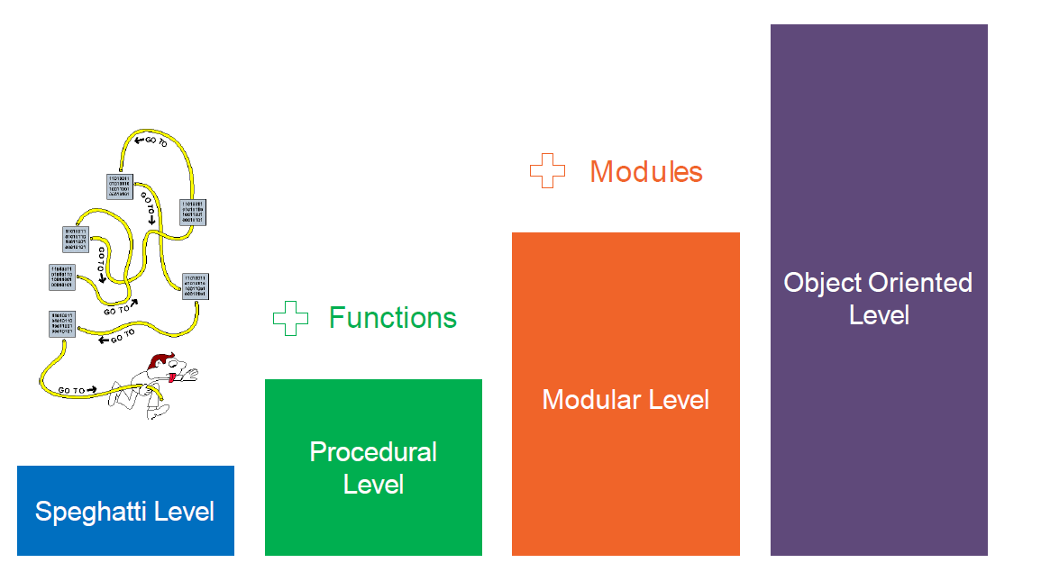
Why OOP

Slide 6
Why OOP
Abstraction
Encapsulation
Polymorphism
Inheritance

Slide 7
OOP Keywords

Slide 8
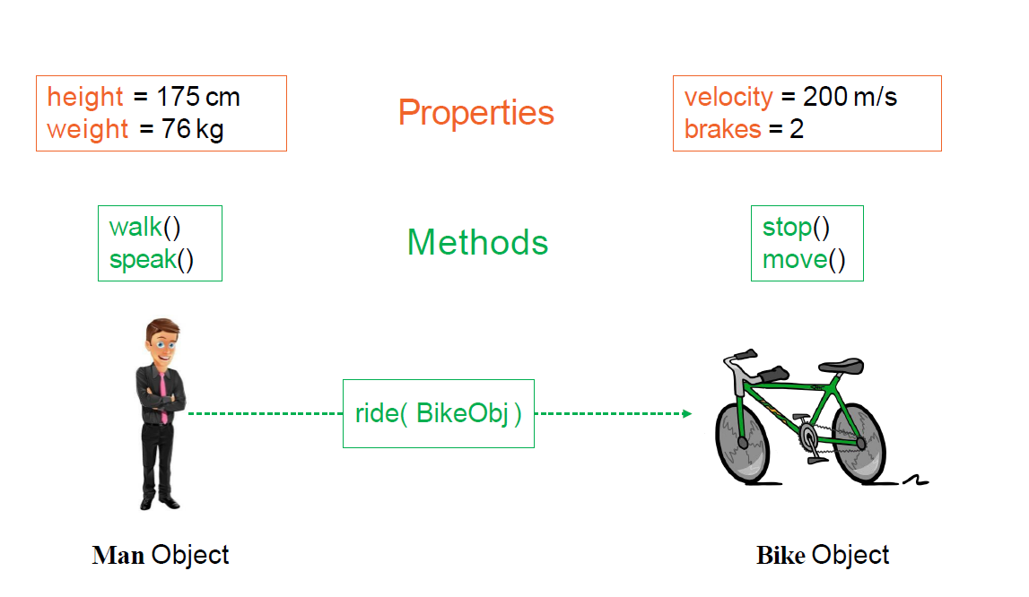
OOP Keywords

Slide 9
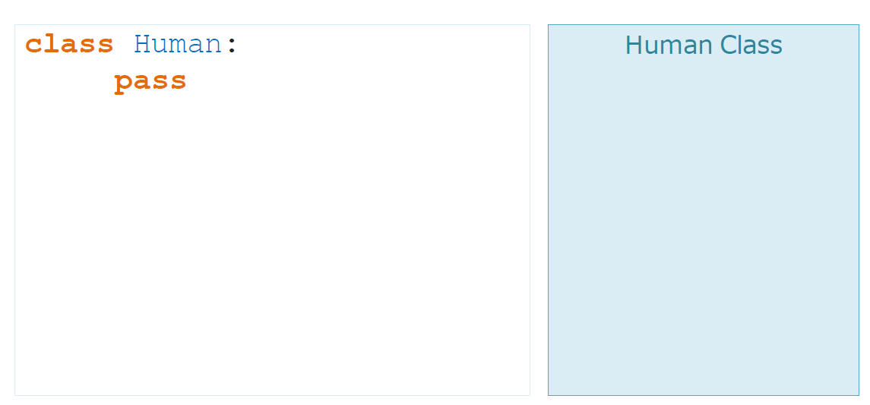
Class
A class is a template definition of an object’s properties and methods.

Slide 10
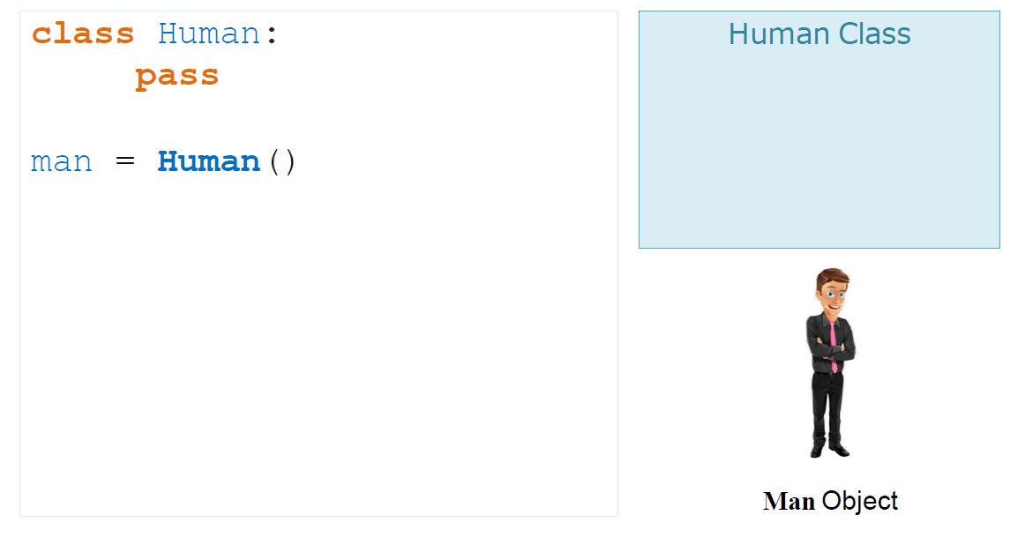
Object
An Object is an instance on a Class.

Slide 11
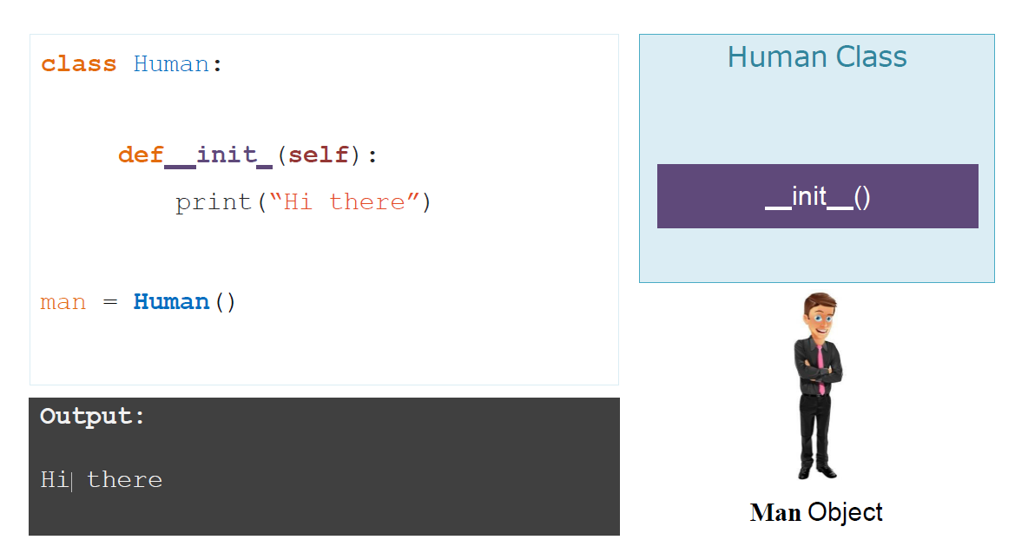
Constructor
is a method called at the moment an object is instantiated.

Slide 12
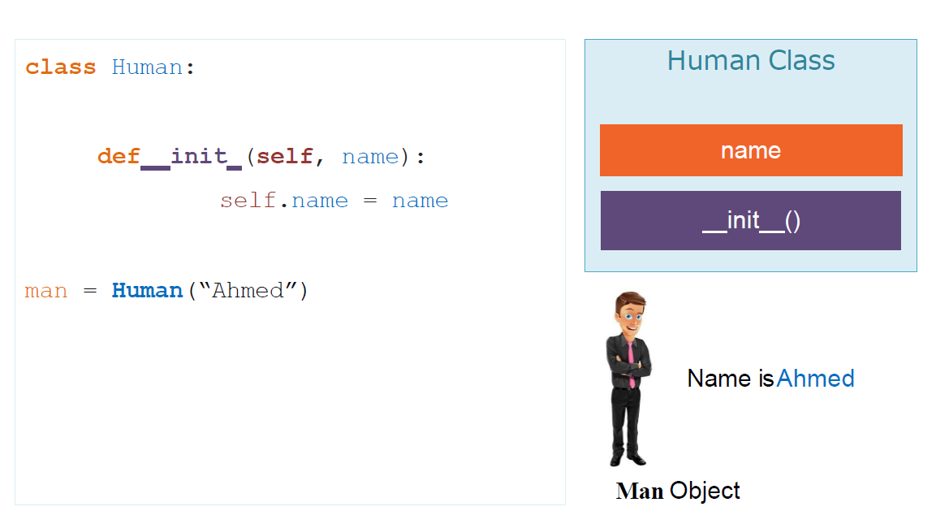
Instance Variable
Is an object characteristic, such as name.

Slide 13
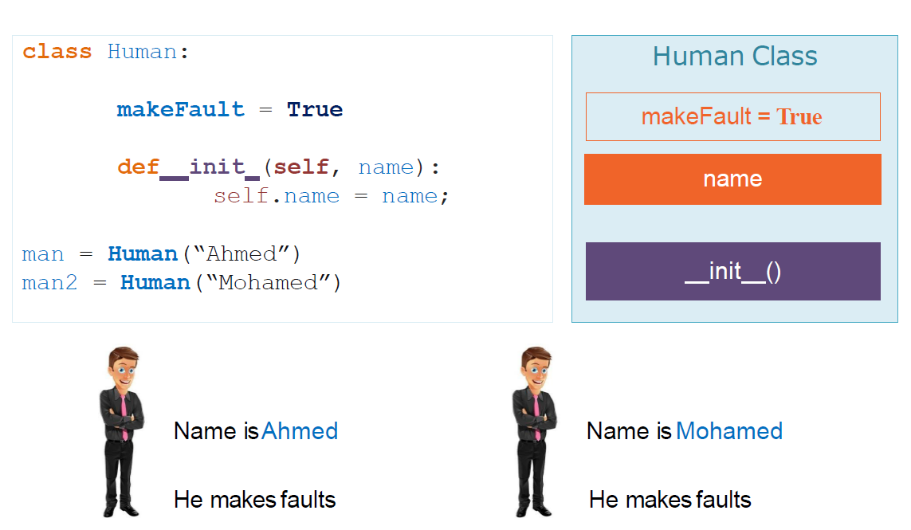
Class Variable
is the variable that shared by all instances.

Slide 14
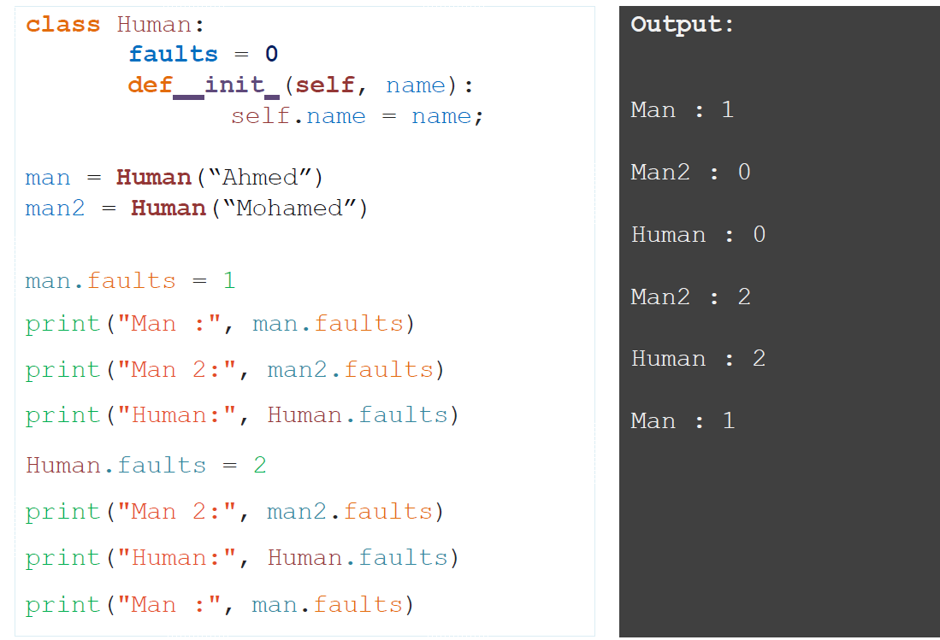
Class Variable

Slide 15
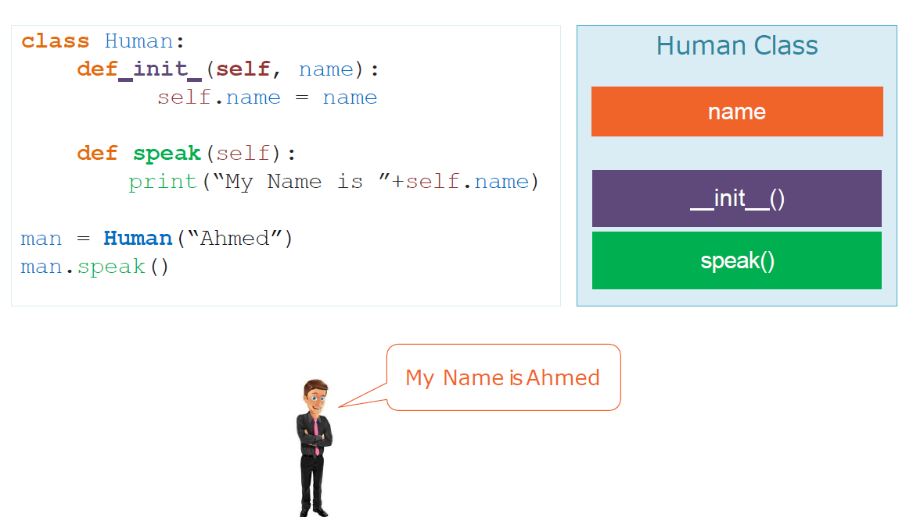
Instance Method
is an object capability(action), such as walk.

Slide 16
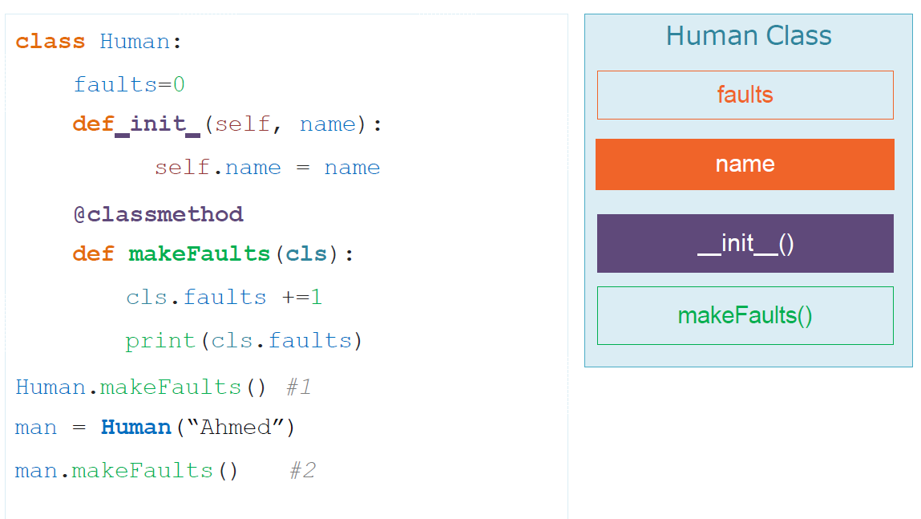
Class Method
is a method that shared by all instances of the Class

Slide 17
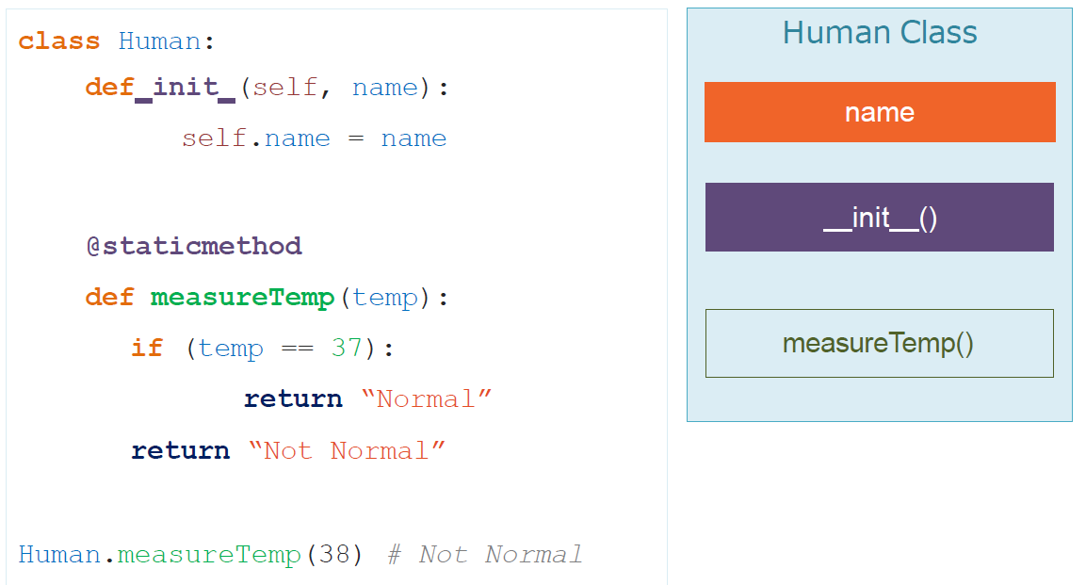
Static Method
is a normal function that have logic that related to the Class

Slide 18
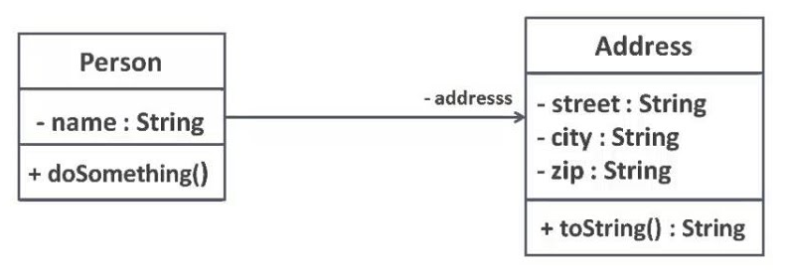
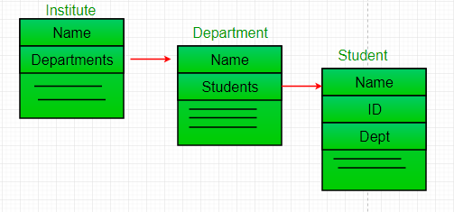
Class Relationships
Association :
object use object
Aggregation
object contain object

Slide 19
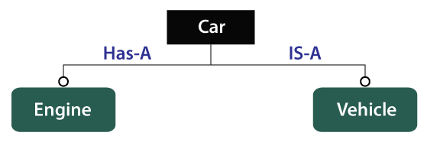
Class Relationships
Composition
object consist of group of object
Inheritance
object is a object

Slide 20

Exercises

Slide 21


